Slide 1
Project Management
CT050-3-3-PRMGT
09: Monitoring & Controlling Projects

Slide 2
Topic & Structure of The Lesson
Knowledge area | Monitoring and controlling process | Outputs
Project integration management | Monitor and control project work Perform integrated change control | Work performance reports Change requests Project management plan updates Project documents updates Approved change requests Project management plan updates Project documents updates
Project scope management | Validate scope Control scope | Accepted deliverables Work performance information Change requests Project documents updates Work performance information Change requests Project management plan updates Project documents updates
Project time management | Control schedule | Work performance information Schedule forecasts Change requests Project management plan updates Project documents updates
Project cost management | Control cost | Work performance information Cost forecasts Change requests Project management plan updates Project documents updates
Project quality management | Control quality | Quality control measurements Verified deliverables Work performance information Change requests Project management plan updates Project documents updates
Project resource management | Control resources | Work performance information Change requests Project management plan updates Project documents updates

Slide 3
Topic & Structure of The Lesson
Knowledge area | Monitoring and controlling process | Outputs
Project communications management | Monitor communications | Work performance information Change requests Project management plan updates Project documents updates
Project stakeholder management | Monitor stakeholder engagement | Work performance information Change requests Project management plan updates Project documents updates
Project risk management | Monitor risks | Work performance information Change requests Project management plan updates Project documents updates Organizational process assets updates
Project procurement management | Control procurements | Closed procurements Work performance information Procurement documentation updates Change requests Project management plan updates Project documents updates Organizational process assets updates

Slide 4
Learning Outcomes
At the end of this topic, You should be able to
List several processes and outputs of project monitoring and controlling, and describe outputs common to all knowledge areas
Discuss monitoring and controlling project work and performing integrated change control as part of project integration management and how to use earned value management
Explain the importance of validating and controlling scope
Describe the schedule control process and schedule performance measurement tools, such as tracking Gantt charts
Discuss tools and techniques to assist in cost control
List the Seven Basic Tools of Quality, and provide examples of how they assist in performing quality control
Explain the process of controlling resources
Summarize methods for monitoring communications
Discuss different approaches to monitoring stakeholder engagement
Describe the process of monitoring risks
Explain how to control procurements

Slide 5
Key Terms You Must Be Able To Use
If you have mastered this topic, you should be able to use the following terms correctly in your assignments and exams:
change requests
work performance information
organizational process assets updates
project management plan updates
project document updates

Slide 6
Project Integration Management
The main monitoring and controlling processes performed as part of project integration management include monitoring and controlling project work and performing integrated change control.
These are crucial processes that must be done well to ensure project success.

Slide 7
Forecasting With Earned Value Management
Earned value management (EVM) is a project performance measurement technique that integrates scope, time, and cost data
Given a baseline, project managers and their teams can determine how well the project is meeting scope, time, and cost goals by entering actual information and then comparing it to the baseline
The baseline information includes:
Scope data (WBS tasks)
Time data (start and finish estimates for each task)
Cost data (cost estimates for each task)
Note that you can use earned value management at either a detailed or a summary level

Slide 8
Earned Value Terms
The planned value (PV) is the authorized budget assigned to scheduled work
The actual cost (AC) is the realized cost incurred for the work performed on an activity during a specific time period
The earned value (EV) is the measure of work performed expressed in terms of the budget authorized for that work. It cannot be greater than the authorized PV budget for a component as it is calculated as the sum of the PV of the completed work

Slide 9
Earned Value Formulas
Term | Formula
Planned Value (PV) | PV = authorized budget assigned to scheduled work
Earned Value (EV) | EV = PV of all completed work
Cost Variance (CV) | CV = EV – AC
Schedule Variance (SV) | SV = EV – PV
Cost Performance Index (CPI) | CPI = EV/AC
Schedule Performance Index (SPI) | SPI = EV/PV
Estimate at Completion (EAC) | EAC = Budget at Completion (BAC)/CPI
Estimate To Complete (ETC) | EAC-AC

Slide 10
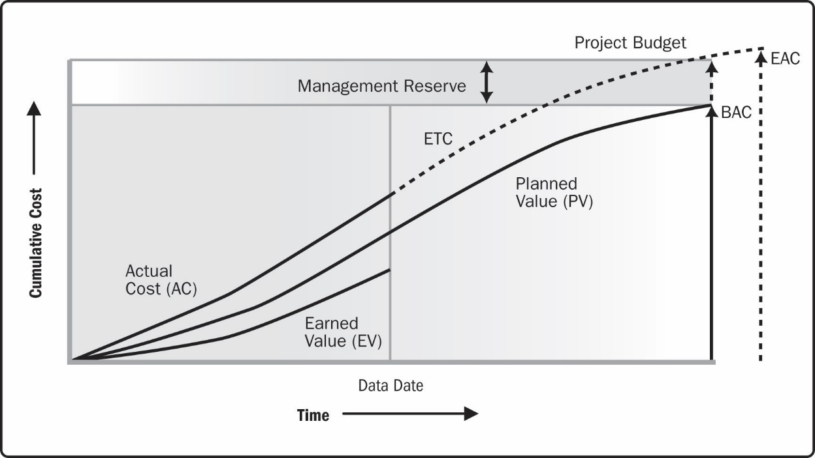
Earned Value, Planned Value, and Actual Cost
Source: Project Management Institute, Inc., A Guide to the Project Management Body of Knowledge (PMBOK® Guide) – Sixth Edition (2017).

Slide 11
Interpreting Earned Value Numbers
In general, negative numbers for cost and schedule variance indicate problems in those areas
Negative numbers mean the project is costing more than planned or taking longer than planned
Likewise, CPI and SPI less than one or less than 100 percent indicate problems

Slide 12
Budget at Completion (BAC)
The budget at completion (BAC), or the approved total budget for the project, can be divided by the cost performance index to calculate the estimate at completion (EAC), which is a forecast of how much the project will cost upon completion. This calculation assumes you will be spending at the same rate as your current level of spending.
Likewise, the approved time estimate for the project can be divided by the schedule performance index to calculate when the project will be completed.
Earned value, therefore, provides an excellent way to monitor project performance and provide forecasts based on performance to date.

Slide 13
Performance Reports
Status reports describe where the project stands at a specific point in time
Progress reports describe what the project team has accomplished during a certain period
Forecasts predict future project status and progress based on past information and trends

Slide 14
Integrated Change Control
Integrated change control involves identifying, evaluating, and managing changes throughout the project’s life cycle
Objectives are as follows:
Influence the factors that cause changes to ensure that changes are beneficial
Determine that a change has occurred
Manage actual changes as they occur
The project management plan provides the baseline for identifying and controlling project changes

Slide 15
Project Scope Management
The main monitoring and controlling processes performed as part of project scope management are validating scope and controlling scope
Key outputs are accepted deliverables and work performance information
It is difficult to create a good project scope statement and WBS; it is often even more difficult to validate the project scope and minimize scope changes

Slide 16
Scope Creep
Even when the project scope is fairly well defined, many projects suffer from scope creep—the tendency for project scope to grow bigger and bigger
There are many horror stories about projects failing due to scope creep
Even for fairly simple projects, people have a tendency to want more
How many people do you know, for example, who said they wanted a simple wedding or a basic new house constructed, only to end up with many more extras than they initially planned?

Slide 17
Validating Scope
Scope validation involves formal acceptance of the completed project deliverables by the project customer or designated stakeholders
Acceptance is often achieved through customer inspection and then sign-off on key deliverables
Recall from Chapter 4 that a verified deliverable has been completed and checked for correctness as part of quality control
The customer is often more than one person, so group decision-making is often required for the inspection and acceptance

Slide 18
Controlling Scope
You cannot control the scope of a project unless you have first clearly defined the scope and set a scope validation process in place
You also need to develop a process for soliciting and monitoring changes to project scope; stakeholders should be encouraged to suggest beneficial changes and discouraged from suggesting unnecessary changes

Slide 19
Project Time Management
The main monitoring and controlling process performed as part of project time management is controlling the schedule or schedule control
Project managers often cite delivering projects on time (schedule control) as one of their biggest challenges, because schedule problems often cause more conflict than other issues
During project initiation, priorities and procedures are often most important, but as the project proceeds, especially during the middle and latter stages of the project, schedule issues become the predominant source of conflict

Slide 20
Sample Work Performance Information
The goal of schedule control is to know the status of the schedule, influence the factors that cause schedule changes, determine whether the schedule has changed, and manage changes when they occur
Key outputs of schedule control are forecasts and work performance information

Slide 21
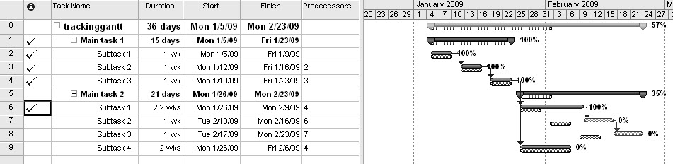
Sample Schedule Performance Measurement Using a Tracking Gantt Chart in Microsoft Project
A tracking Gantt chart compares planned and actual project schedule information
A slipped milestone refers to a milestone activity that was actually completed later than originally planned

Slide 22
No Surprises
Top management hates surprises, so the project manager must be clear and honest in communicating project status
By no means should project managers create the illusion that the project is going fine when, in fact, serious problems have emerged

Slide 23
Project Cost Management
Cost control includes monitoring cost performance, ensuring that only appropriate project changes are included in a revised cost baseline, and informing project stakeholders of authorized changes to the project that will affect costs
Outputs include work performance information, cost forecasts, change requests, project management plan updates, and project documents updates

Slide 24
Tools and Techniques for Controlling Costs
Expert judgment
Data analysis
Project management information systems
To-complete performance index (TCPI), which is a measure of the cost performance that must be achieved on the remaining work in order to meet a specified goal, such as the BAC or EAC

Slide 25
Project Quality Management
Key outputs of quality control include quality-control measurements, verified deliverables, work performance information, change requests, project management plan updates, and project documents updates
Outcomes are acceptance decisions, rework, and process adjustments

Slide 26
Sample Quality-Control Tools
Data gathering: Checklists, check sheets, statistical sampling, questionnaires, and surveys
Data analysis: Performance reviews and root cause analysis
Inspection
Testing/product evaluations
Data representation: cause-and-effect diagrams, control charts, histograms, and scatter diagrams
Meetings

Slide 27
Seven Basic Tools of Quality (ASQ)
Cause-and-effect diagrams: Help you find the root cause of quality problems
Check sheets: Also called a tally sheets, are structured forms for collecting and analyzing data
Control charts: Illustrate the results of a process over time and show if a process is in control
Histograms: Show a bar graph of a distribution of variables
Pareto charts: Help you identify and prioritize problem areas
Scatter diagrams: Show if there is a relationship between two variables
Stratification: A technique used to separate data to see patterns in data.
A run chart displays the history and pattern of variation of a process over time.
A flow chart is a graphical display of the logic and flow of processes that help you analyze how problems occur and how processes can be improved

Slide 28
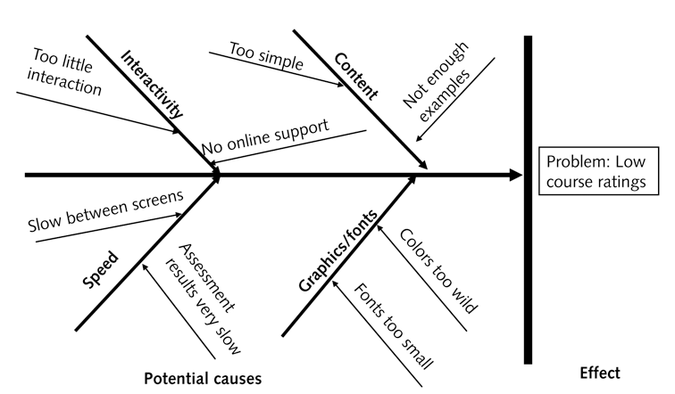
Sample Cause-and Effect Diagram

Slide 29
Sample check sheet
Defect | Day 1 | Day 2 | Day 3 | Day 4 | Total
Broken link | 5 | 3 | 2 | 4 | 14
Spelling error | 2 | 1 | 2 | 2 | 7
Wrong format | 3 | 2 | 4 | 1 | 10

Slide 30
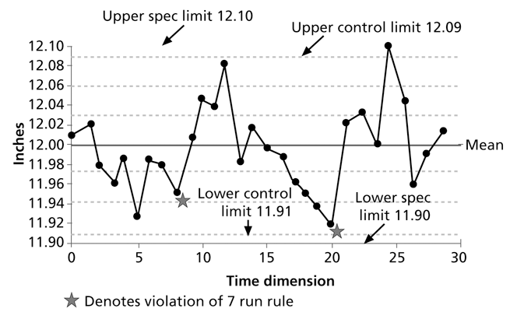
Sample Control Chart

Slide 31
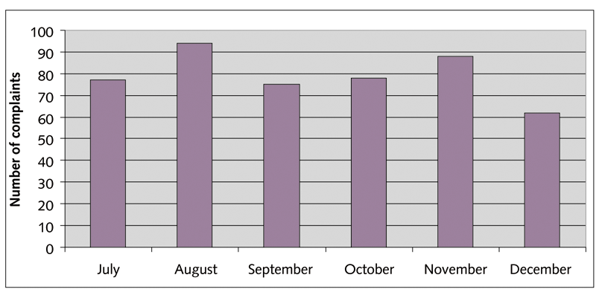
Sample Histogram

Slide 32
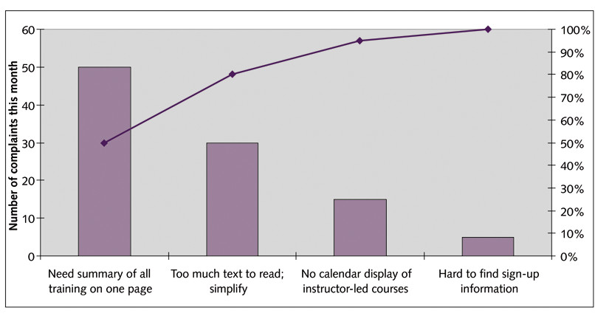
Sample Pareto Chart

Slide 33
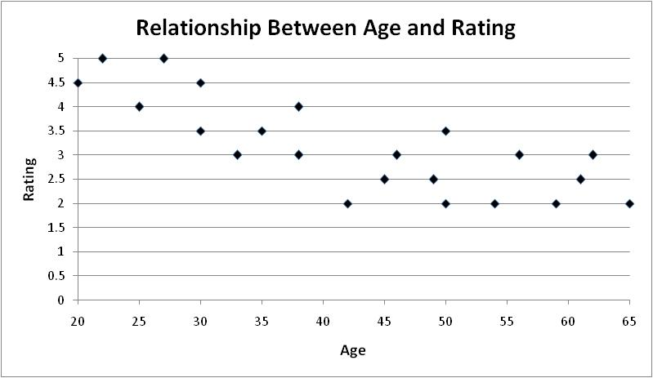
Sample Scatter Diagram

Slide 34
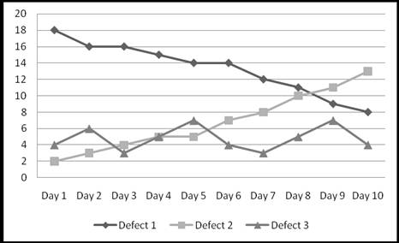
Sample Run Chart

Slide 35
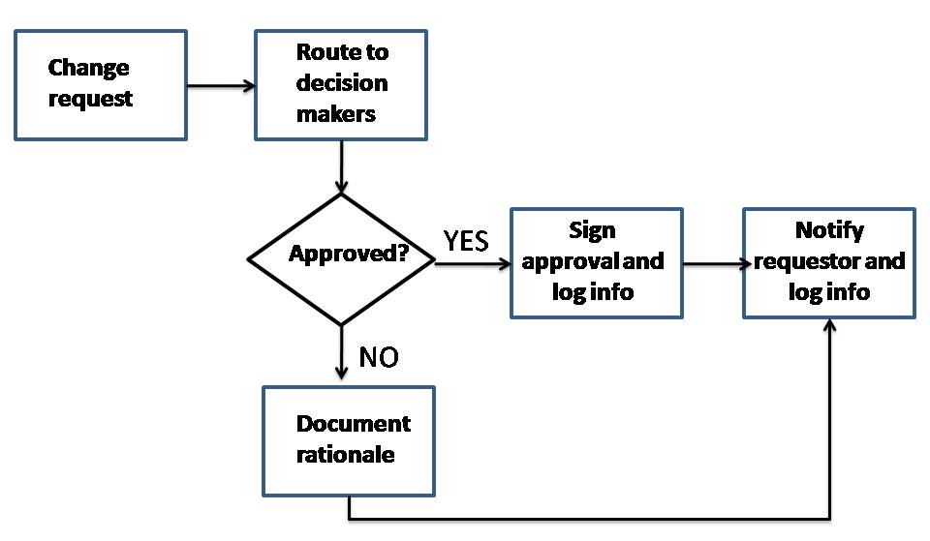
Sample Flowchart

Slide 36
Project Resource Management
Controlling resources involves ensuring that the physical resources assigned to the project are available as planned and monitoring the planned versus actual resources utilization, taking corrective actions as needed
Making effective use of team members is addressed under the Manage Team process
Tools and techniques include data analysis, problem solving, interpersonal and team skills, and project management information systems
Key outputs include work performance information, change requests, project management plan updates, and project documents updates.

Slide 37
Project Communications Management
Controlling communications involves monitoring and controlling communications throughout the project life cycle to ensure that stakeholder information needs are met
Key outputs include work performance information, change requests, project management plan updates, and project documents updates

Slide 38
Project Stakeholder Management
You cannot control stakeholders, but you can control their level of engagement
Controlling stakeholder engagement involves monitoring overall project stakeholder relationships and adjusting strategies and plans for engaging stakeholders as needed
Outputs include work performance information, change requests, project management plan updates, and project documents updates
On some projects key stakeholders are members of the project team

Slide 39
Project Risk Management
Monitoring and controlling risks involves implementing the risk response plans, while continuing to identify and analyze new risks and evaluate risk process effectiveness
Carrying out individual risk management plans involves monitoring risks based on defined milestones and making decisions regarding risks and their response strategies
Project teams sometimes use workarounds—unplanned responses to risk events—when they do not have contingency plans in place
Outputs of risk control include work performance information, change requests, project management plan updates, project documents updates (especially updating the risk register), and organizational process assets updates

Slide 40
Project Procurement Management
Controlling procurements involves managing procurement relationships, monitoring contract performance, making changes and taking corrective actions as needed, and closing out contracts
The contractual relationship is a legal relationship and, as such, is subject to state and federal contract laws
Someone from the procurement or legal department in organizations usually closes out contracts
In addition to work performance information, change requests, project management plan updates, project documents updates, and organizational process asset updates, key outputs of controlling procurements include closed procurements and procurement documentation updates

Slide 41
Quick Review Question

Slide 42
Summary of Main Teaching Points
Monitoring and controlling involves regularly measuring progress to ensure that the project is meeting its objectives and addressing current business needs. The project manager and other staff monitor progress against plans and take corrective action when necessary.
Every knowledge area includes processes and outputs to help monitor and control projects. Outputs common to several knowledge areas include change requests, work performance information, organizational process assets updates, project management plan updates, and project document updates.

Slide 43
Question and Answer Session
Q & A

Slide 44
What we will cover next
10 Closing Projects

